Slide 1

Optical Character recognition Bangla Language using Deep learning
Members:
Johirul Islam Tutul (19202103001)
Mahanur Alam (19202103030)
Nabila Rahman (19202103056)
Tanmoy Islam Opu(19202103026)
Tanvir Ahmed (19202103424)
Supervised by: Khan Md. Hasib, Assistant Professor Department of Computer Science and Engineering(CSE) Bangladesh University of Business and Technology(BUBT)

Slide 2
Presentation Outline
1
Introduction
Proposed Methodology
5
2
Problem Stat.
6
Conclusions
Contribution
3
7
4
Bibliography
Background & Related Work

Slide 3
Introduction
Optical Character recognition Bangla Language using Deep learning
Optical Character Recognition (OCR) is a technology that enables the recognition of text in digital images or scanned documents. It is a process of converting printed or handwritten text into machine-encoded text. OCR has been used to convert many languages into machine-readable forms, including Bangla.

Slide 4

Problem Statement
“The primary objective of this project is to design and implement an accurate and efficient OCR system for Bangla language documents using deep learning methodologies.”
Claimed Contribution
Dataset Collection
i
Preprocessing and Data Augmentation
ii
Training and Optimization
iii
Deployment and User Interface
iv

Slide 5

Background & Related Work
Optical Character Recognition (OCR) is a technology that aims to convert images or scanned documents containing printed or handwritten text into machine-encoded text.
Building a large and diverse dataset of Bangla characters, words, and sentences is crucial for training and evaluating OCR models. Researchers have compiled and released publicly available datasets containing Bangla characters and texts, such as BanglaLekha-Isolated, BanglaLekha-Connected
User Experience and Interaction Design
This work focuses on enhancing the user experience and interaction design aspects of deep learning-based OCR Common preprocessing steps include image binarization, noise removal, skew correction, and segmentation.

Slide 6
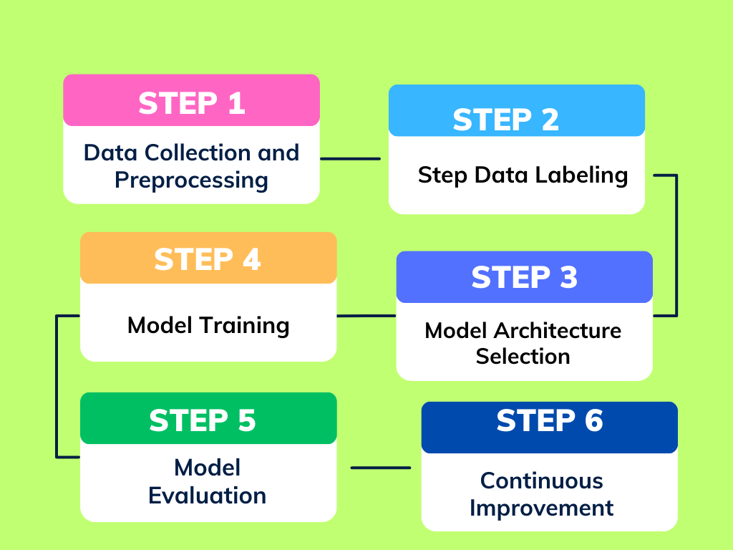
Proposed Methodology
Step 1: Data Collection and Preprocessing
1.1 Collect a large dataset of handwritten Bangla characters and digits. The dataset should include various writing styles and variations to ensure diversity.
1.2 Preprocess the data to normalize and standardize the images. Convert them to grayscale and resize them to a fixed dimension to facilitate training.
Step 2: Data Labeling
2.1 Manually label each image in the dataset with the corresponding Bangla character or digit to create a labeled dataset for supervised learning.
Step 3: Model Architecture Selection
3.1 Choose a Convolutional Neural Network (CNN) architecture suitable for character recognition tasks. The CNN architecture is well-suited to handle image data and learn features effectively.

Slide 7
Methodology(Contd.)
Step 4: Model Training
4.1 Train the chosen CNN model on the training data using a suitable optimization algorithm
Step 5: Model Evaluation
5.1 Evaluate the trained model on a separate test dataset that was not used during training. Measure performance metrics such as accuracy
Step 6: Continuous Improvement
5.2 Regularly update and retrain the OCR model with new data to adapt to changing handwriting styles and improve recognition performance

Slide 8
Conclusions
Accuracy Improvement
Our proposed methodology is able to overcome shortcomings
i
Data Availability
ii
More analysis is needed to overcome the working process.
Language Complexity
iii
Required to implement for Real time scenario
Real-World Applications
iv

Slide 9
Bibliography
1. | Bangla Optical Character Recognition through Segmenta- tion using Curvature Distance and Multilayer Perceptron Algorithm. DOI: 10.1109/ECACE.2017.7912914
2. | A Feature Fusion Based Optical Character Recognition of Bangla Characters Using Support Vector Machine. DOI: 10.1109/EICT.2017.8275138
3. | Bangla handwritten character recognition using MobileNet V1 architecture. DOI: https://doi.org/10.11591/eei.v9i6.2234
4. | Bangla Handwritten Character Recognition Using Local Binary Pattern And Its Variants Bengali Handwritten Words. DOI: 10.1109/IMCOM53663.2022.9721634
5. | BornoNet: Bangla Handwritten Characters Recognition Using Convolutional Neural Network.https://doi.org/10.1016/j.procs.2018.10.426
6. | End-to-End Optical Character Recognition for Bengali Handwritten Words. DOI:10.1109/NCCC49330.2021.9428809
7. | A Complete Bangla Optical Character Recognition System: An Effective Approach. DOI: 10.1109/ICCIT48885.2019.9038551
8. | Handwritten Isolated Bangla Compound Character Recognition. DOI:10.1109/ECACE.2019.8679258
9. | Bangla Optical Character Recognition and Text-to-Speech Conversion using Raspberry Pi. https://www.researchgate.net/profile/Al-Amin-Biswas/publication/342815399_Bangla_Optical_Character_Recognition_and_Text-to-Speech_Conversion_using_Raspberry_Pi/links/5f073aaaa6fdcc4ca459c513/Bangla-Optical-Character-Recognition-and-Text-to-Speech-Conversion-using-Raspberry-Pi.pdf
10. | "10.Decision Tree-Based Recognition of Bangla Text from Out- door Scene Images." https://doi.org/10.1007/978-3-642-24965-5_61
11. | "Optical Character Recognition of Bangla Characters using neural network: A better approach"

Slide 10
Bibliography..
12. | . K. Demestichas, N. Peppes, and T. Alexakis, “Survey on security threats in agricultural iot and smart farming,” Sensors, vol. 20, no. 22, p. 6458, 2020
13. | A Complete Workflow for Development of Bangla OCR https://doi.org/10.48550/arXiv.1204.1198
14. | .OCR for Printed Bangla Characters Using Neural Network " 10.5815/ijmecs.2020.02.03
15. | "Research Report on Bangla Optical Character Recognition Using Kohonen network "
16. | "Bangali Handwritten Characters Classification Using Deep Convolutional Neural Network" http://hdl.handle.net/10361/17653
17. | "Bangla Handwritten Character Recognition Using Deep Convolutional Autoencoder Neural Network" https://doi.org/10.1109/ICAICT51780.2020.9333472
18. | "Bangla Handwritten Character Recognition Using Deep Belief Network " https://doi.org/10.1109/EICT.2014.6777907
19. | "Bangla Handwritten Digit Recognitio Using Autoencoder and Deep Convolutional Neural Network" https://doi.org/10.1109/IWCI.2016.7860340
20. | "Two-Handed Hand Gesture Recognition for Bangla Sign Language using LDA and ANN" https://doi.org/10.1109/SKIMA.2014.7083527

Slide 11
Thank You
Any Questions?

